Slide 1
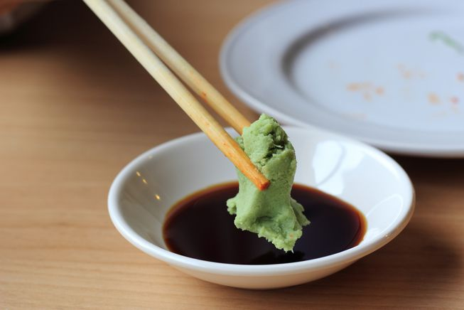
WASABI Cards
A starting point to improve your meetings, continuously
DESIGN
Work Visually
BUILD
Engage
DEFINE
Co-create
in Team
Tailor
USE
Ad-Hoc
OBSERVE
Improve

Slide 2
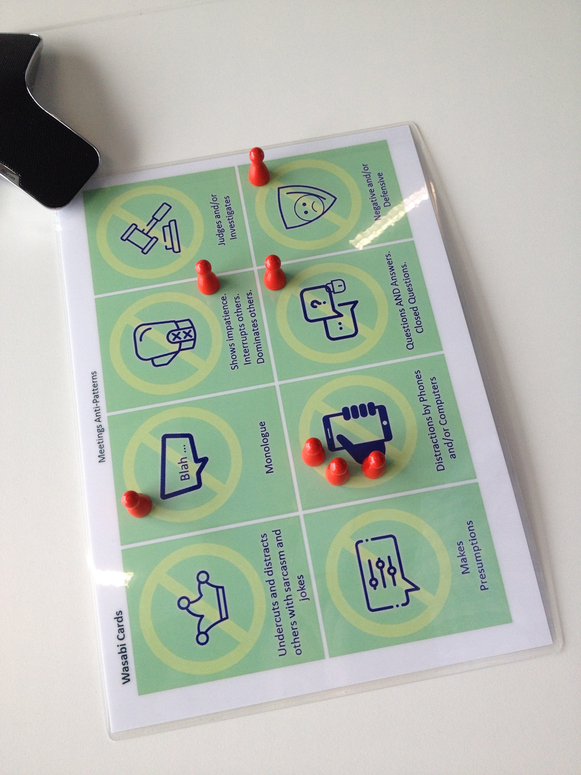
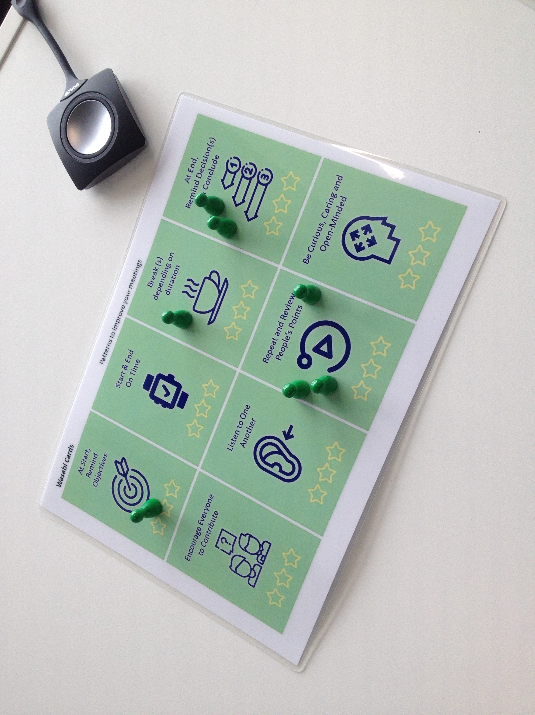
WASABI Cards
Each attendees gets a number of points at the beginning of the meeting, and places them on patterns and/or anti-patterns cards he has noticed during the session., in real time or at the end, before debriefing.
Table Set

Slide 3
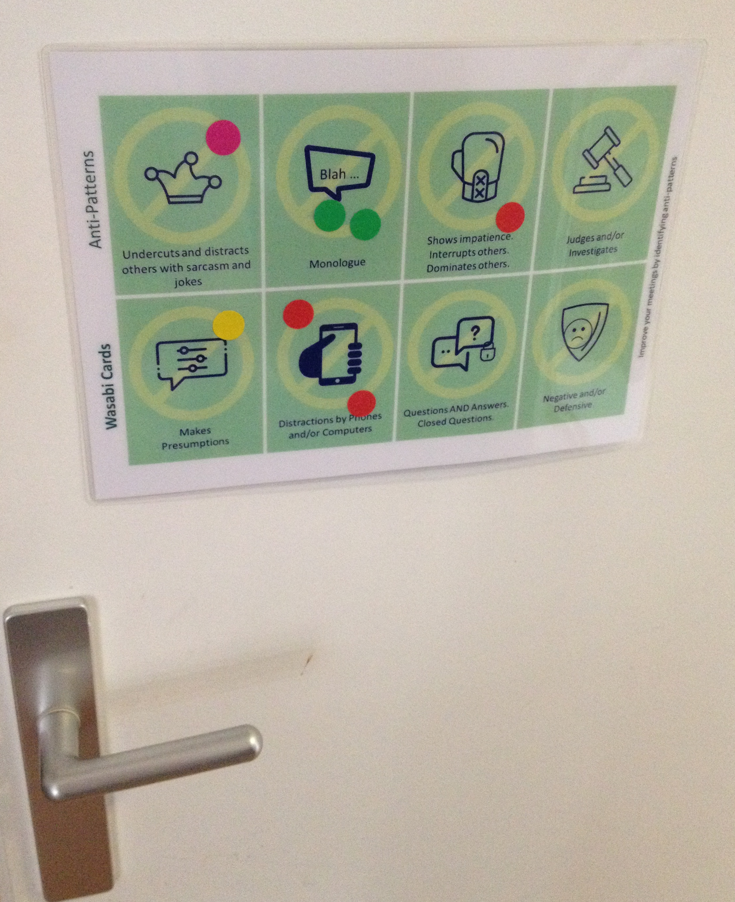
WASABI Cards
Feedback Door
Before leaving the room, each attendee places a dot on each pattern and anti-pattern he has noticed during the session. A global session for debriefing is done periodically.

Slide 4
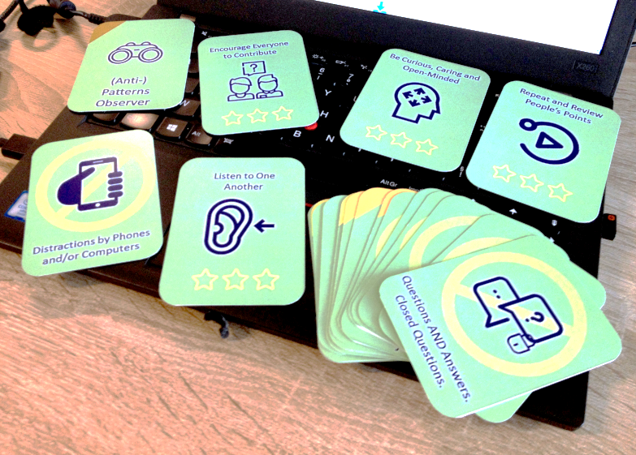
WASABI Cards
Real Time / Serious Game
Real Time
Each attendees chooses one or more cards - role, pattern and anti-pattern - he wants to work on during the meeting.
Serious Game
Each attendees chooses one behavior he wants to work on during the game. The team decides which set of cards to use per game.
Tripp and Tyler
TV Series
Animals ‘ Ark Game …
Play - Feel - Guess

Slide 5
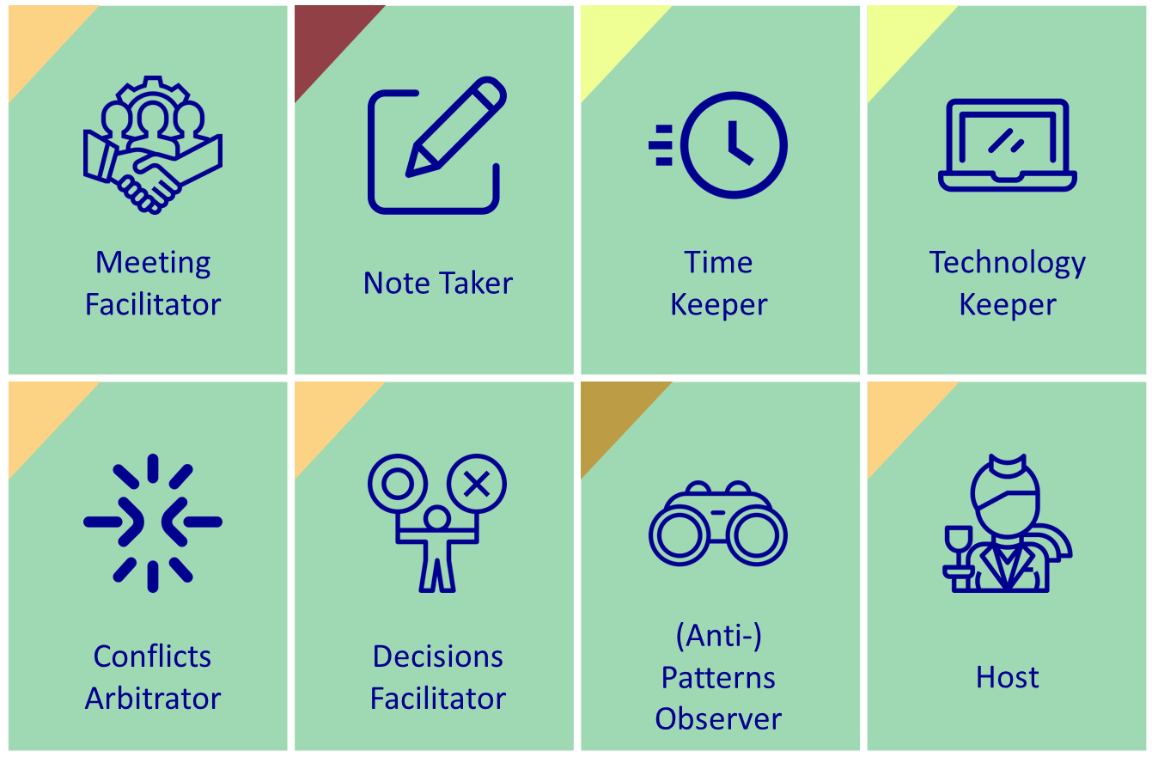
WASABI Cards
Roles

Slide 6
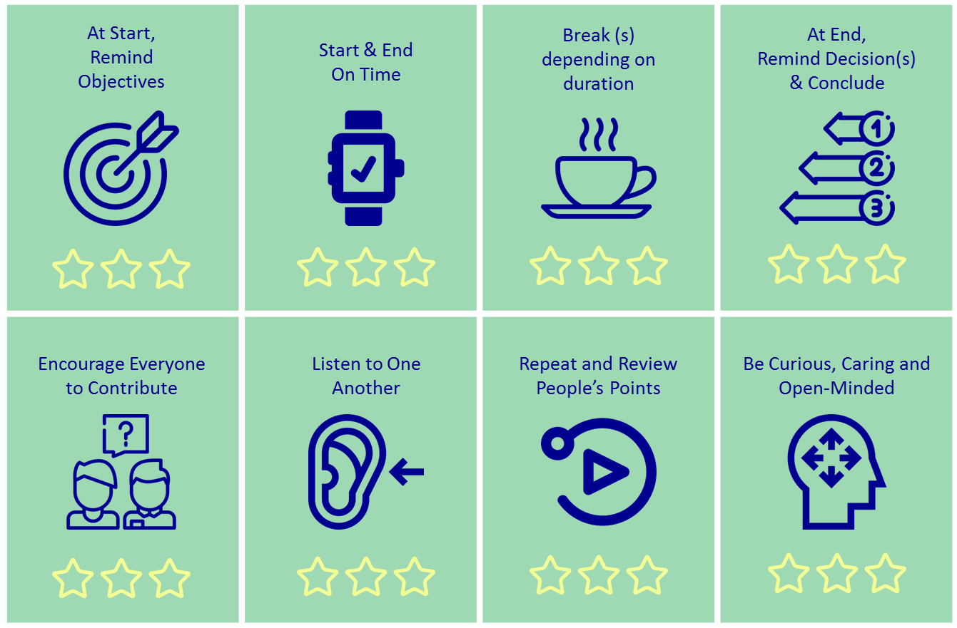
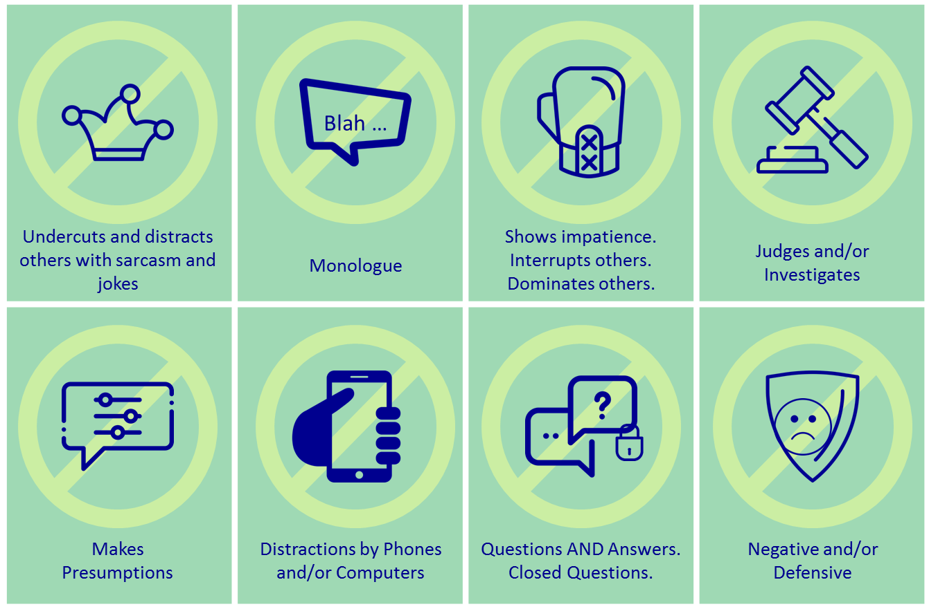
WASABI Cards
Patterns / Anti-Patterns

Slide 7
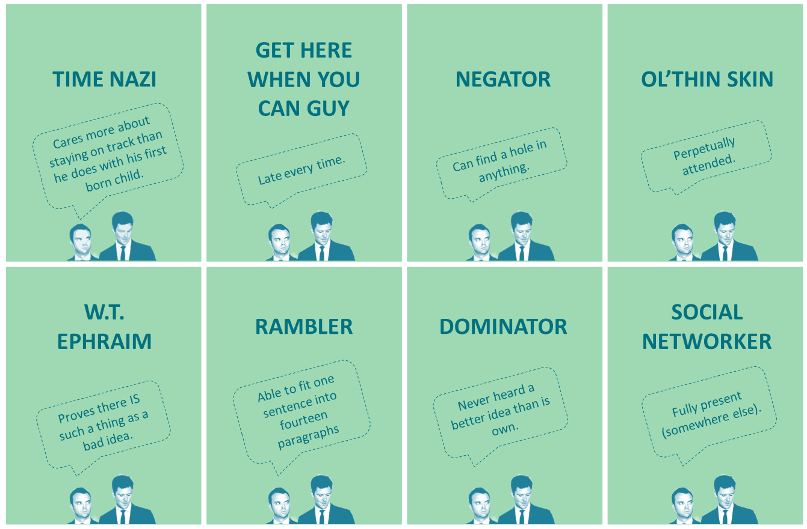
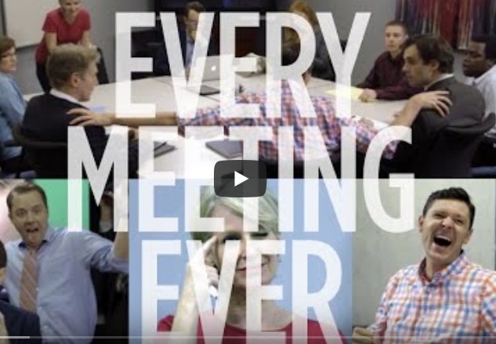
WASABI Cards
Behavioral Archetypes : Tripp & Tyler
Notes:
https://www.youtube.com/watch?v=K7agjXFFQJU

Slide 8
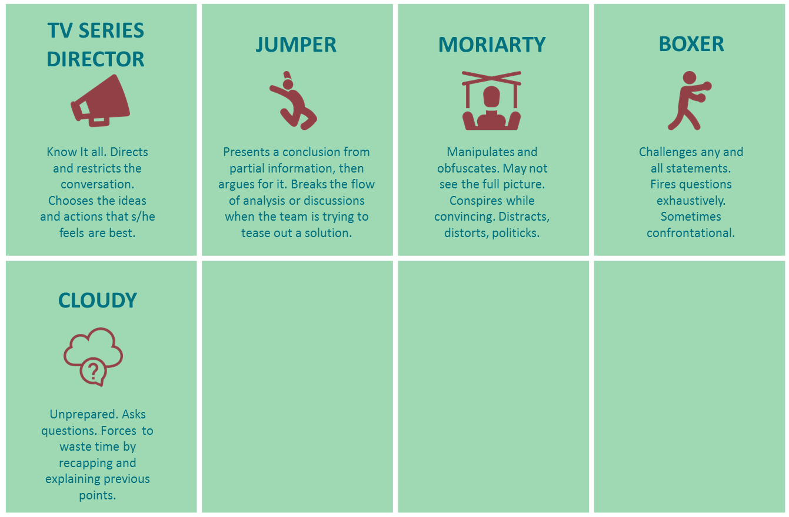
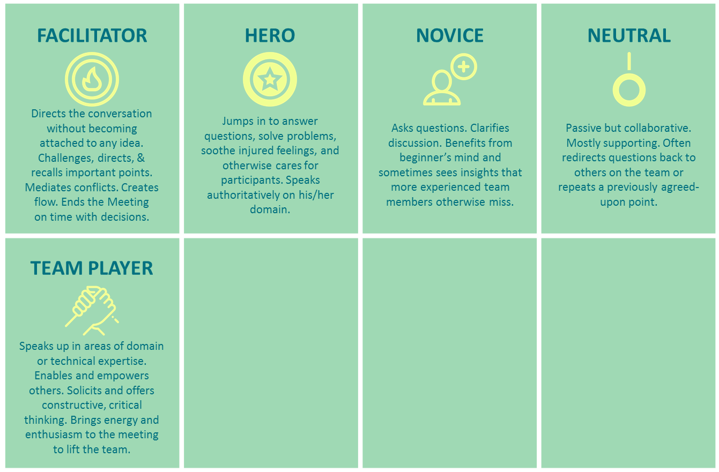
WASABI Cards
Behavioral Archetypes : TV Series
Create next season(s) with your own archetypes
Notes:
Yvonne Chen

Slide 9
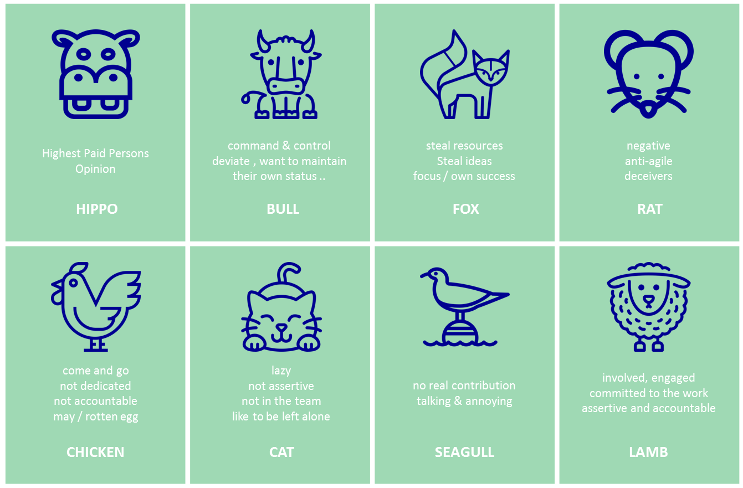
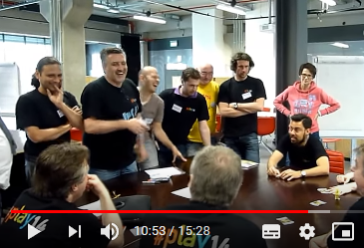
WASABI Cards
Behavioral Archetypes : Animals’ Ark Game
Notes:
Mario Moreira, Pierre Neis, Mehdi Touarigt

Slide 10

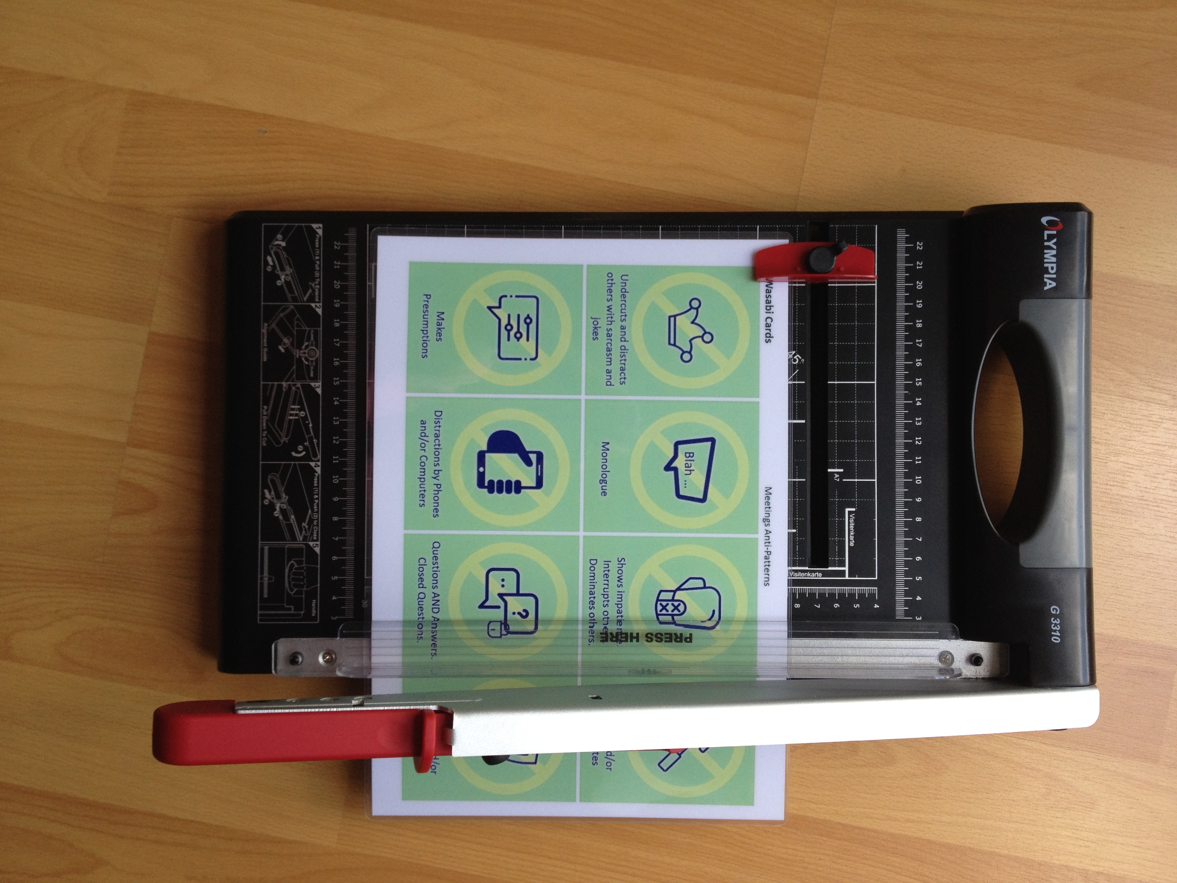
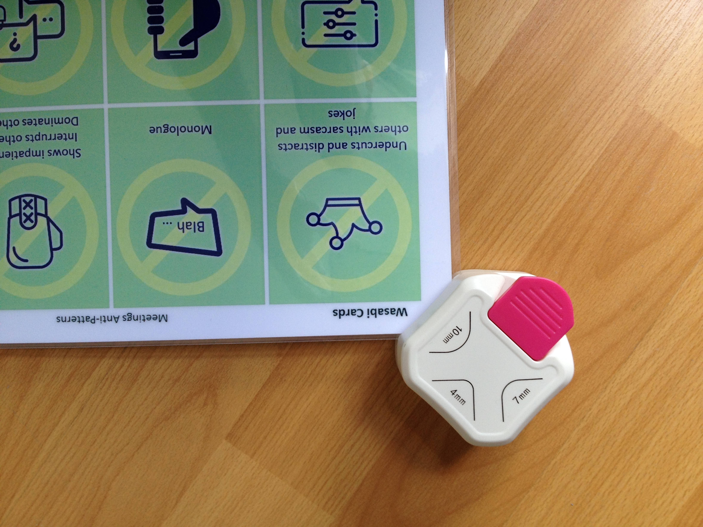
It’s a kit for your own purpose
- PPT templates
- Color Printers
- Cutting Tools
- Plasticization

Slide 11
WASABI Cards
A starting point to improve your meetings, continuously
R-DESIGN
Work Visually
BUILD
R-DEFINE
Manually
Co-create
in Team
Choose & Tailor
PRACTICE
As you decided
OBSERVE
Improve

Slide 12

it takes time & conditions
for each wasabi plant to grow

